Slide 1

NOV 2023
REPORT
ANALYSIS
YOUTUBE STREAMERS ANALYSIS
BY
CHRISTOPHER AGBI

Slide 2
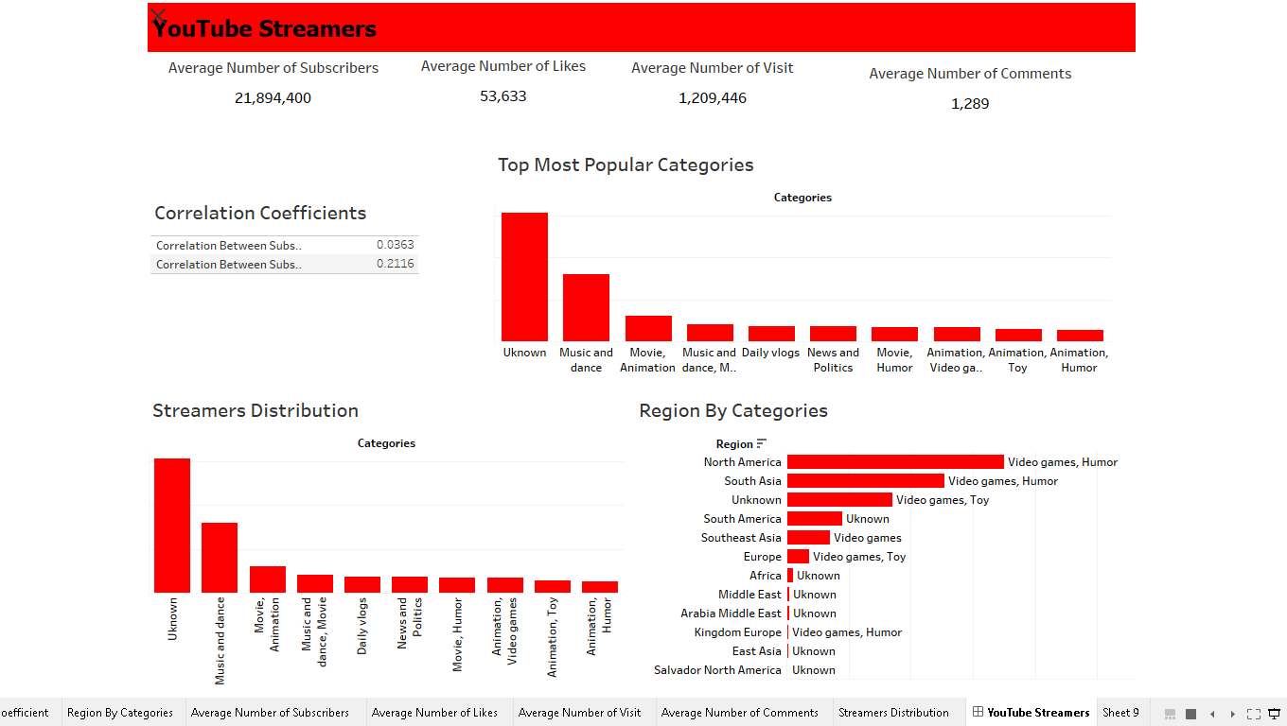
YouTube Streamers Dashboard

Slide 3
Top 10 Most Popular Categories
From the dashboard above we see that the Unknown category has the highest number of subscribers .
That makes the Unknown category the most popular.

Slide 4
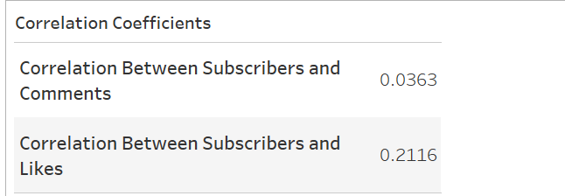
Correlation Coefficient for Subscribers&Likes and Subscribes&Comments
Yes, there is a correlation between the number of subscribers and the number of likes, and also between the number of subscribers and the number of comments. The correlation coefficients obtained indicate these relationships:
-Correlation between Subscribers and Likes:0.2116 (positive correlation)
- Correlation between Subscribers and Comments:0.0363 (positive correlation)
While both correlations are positive, they are relatively weak.
The positive correlation suggests that as the number of subscribers increases, there is a tendency for the number of likes and comments to increase as well, but the relationships are not very strong based on the obtained correlation coefficients.

Slide 5
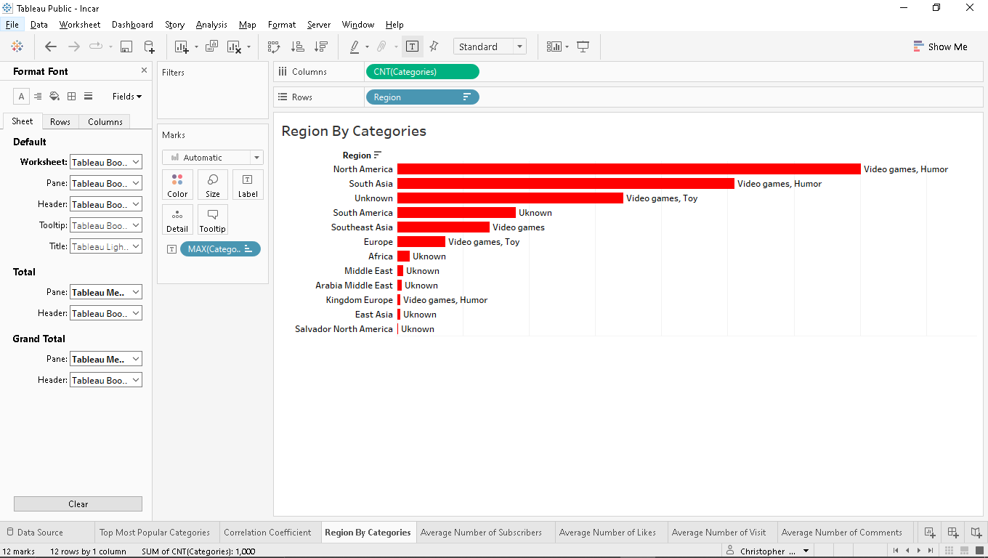
Categories by Region
Based on the provided dashboard there are discernible regional preference.
While some have clear preference, others regions like South America, Africa, Middle East, Arabic Middle East, East Asia and Salvador North America preferred watching content from the unknown category.
And also most of the region preferred video games even they though had another category they preferred.

Slide 6
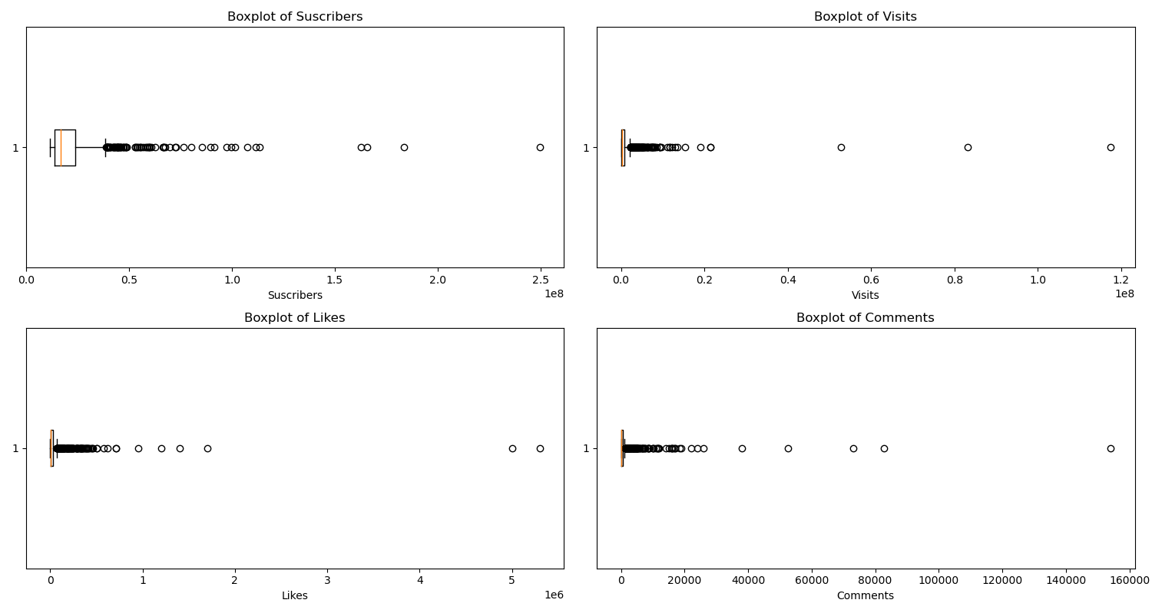
Engagement Anomalies
Notes:
6

Slide 7
Engagement Anomalies
In the analysis of the provided box plots in the previous slide, for subscribers, likes, visits, and comments, notable anomalies were identified, indicating potential areas of interest and further investigation. Here are specific observations for each metric:
Subscribers:
  Description: The box plot for subscribers revealed an outlier on the upper end of the distribution, suggesting an unusual spike in subscriber counts. This anomaly may warrant exploration to understand the factors contributing to this significant increase.
Likes:
  Description: Anomalous data points were observed in the likes box plot, specifically on the lower end of the distribution. This indicates instances where the number of likes deviated significantly from the typical range. Investigating these anomalies could provide insights into content that received lower engagement.
Visits:
  Description: The box plot for visits showcased a few data points as outliers, signaling instances of unusually high or low visit counts. Identifying the causes behind these anomalies is crucial for understanding factors influencing website traffic.
Comments:
  Description: Anomalies in the comments box plot were evident, particularly in the form of outliers with significantly higher or lower comment counts. Investigating these outliers can shed light on content that generated exceptional user engagement or areas requiring improvement.

Slide 8
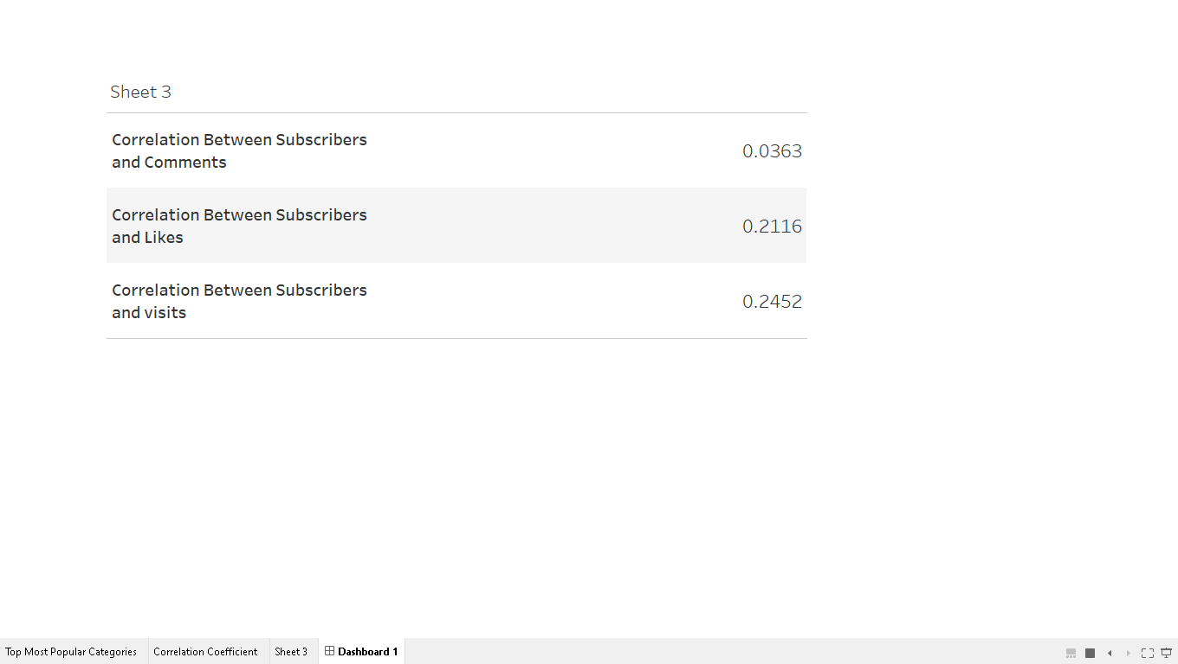
The correlation suggest patterns, particularly in the positive relationship subscribers and likes, subscribers and visits,
but they are not very strong. The weak correlation with comments indicates less or clear pattern in that relationship.
The very weak correlation between subscribers and comments doesn‘t necessarily indicates an anomaly. It suggests that
there is little linear relationship between the number of subscribers and the average number of comments.
Anomalies are typically identified when there are significant deviations from expected or established patterns. In this case, it
might be more accurate to say that the number of comments doesn’t exhibit a strong linear pattern with the numbers of
subscribers, rather than classifying it as a clear anomaly.

Slide 9
Streamers Distributions
Based on the provided dashboard we can see the Unknown Category has the highest number of YouTube streamers, follow by the Music and dance, Movies and Animation, Music and danceMovies and so on

Slide 10
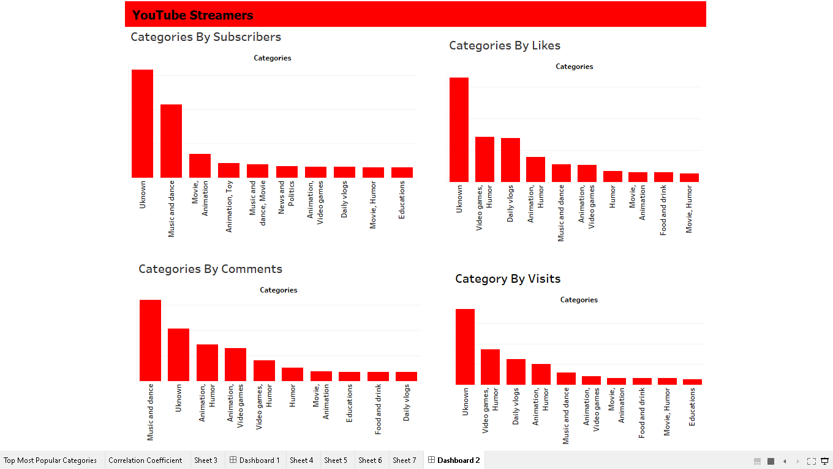
Performance Metrics of Various Categories

Slide 11
Performance Metrics of Various Categories
In the previous dashboard, distinct categories exhibit notable achievements in different engagement contexts. Specifically, certain categories stand out for their high performance metrics in terms of subscribers, likes, comments, and visits. The content related to subscribing demonstrates excellence in categories such as Unknown, Music and Dance, Animation, Daily Vlogs, Video Games, News and Politics and so on. Likewise, in the realm of likes and visits, these categories continue to shine, showcasing exceptional performance. Furthermore, the Music and Dance category emerges as a standout performer in terms of comments. This comprehensive analysis provides valuable insights into the diverse strengths of each category within your content context.

Slide 12
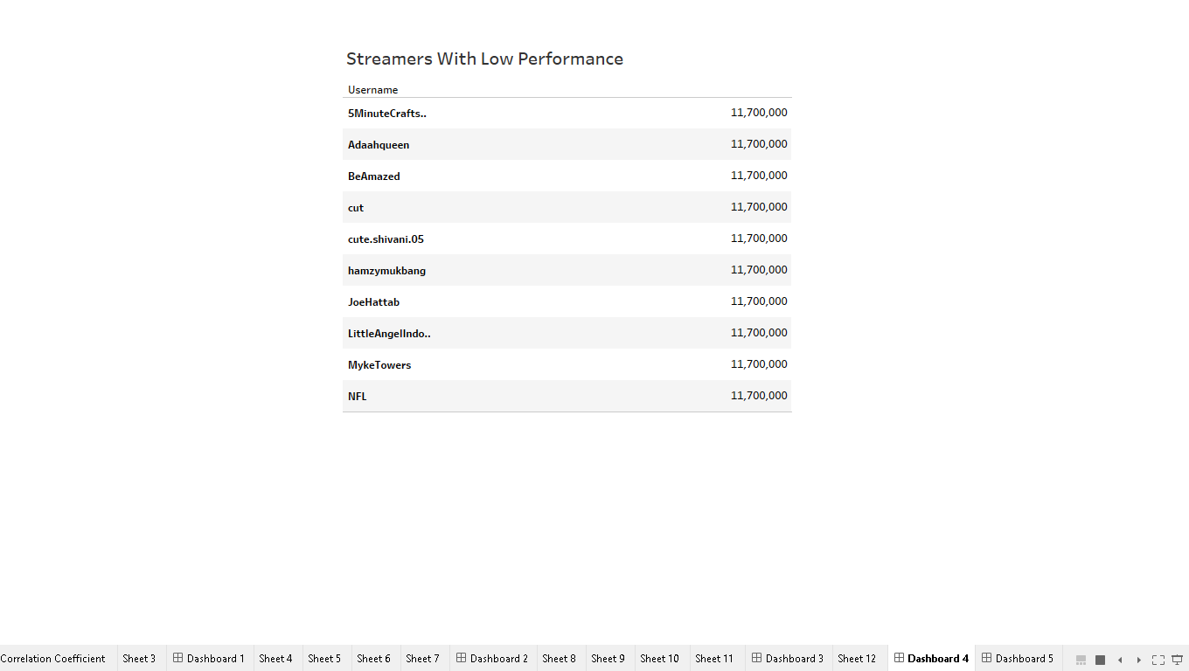
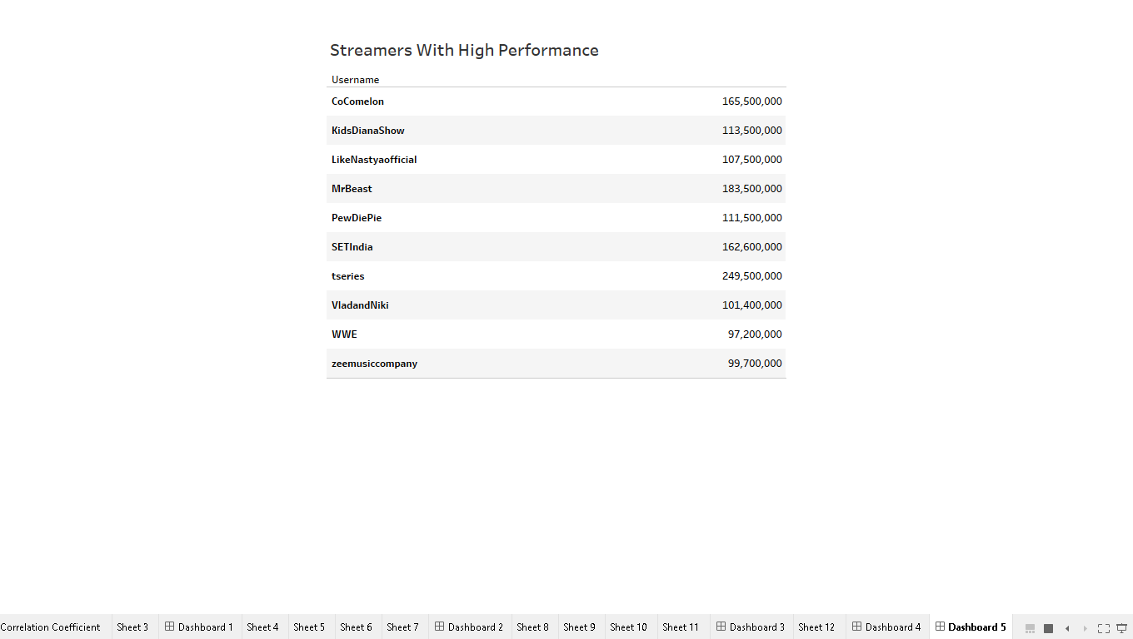
Collaboration Impact: Unveiling Performance Metrics in Streamers with and without Collaborations

Slide 13
Collaboration Impact: Unveiling Performance Metrics in Streamers with and without Collaborations
The presence of brand collaborations is not solely determined by high performance metrics. Even streamers or entities with lower performance metrics can secure brand collaborations. For example, the NFL, despite potentially lower individual metrics, has collaborated with prominent brands such as CBS, Amazon, and ESPN. On the other hand, high-profile influencers like MrBeast, known for substantial performance metrics, have successfully engaged in collaborations with brands like TikTok, Quidd, and Lotto. This illustrates that various factors beyond raw performance metrics contribute to attracting brand partnerships in the diverse landscape of influencer marketing.

Slide 14
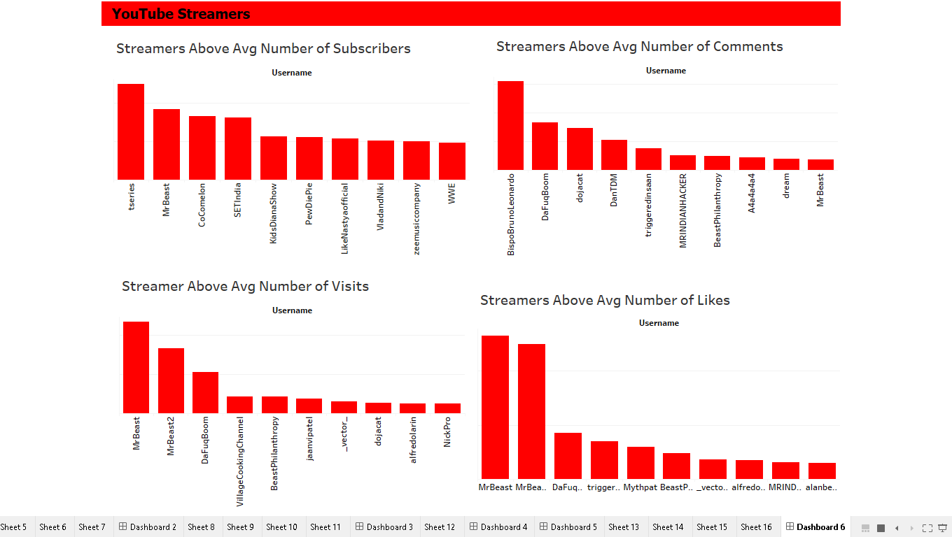
Streamers Above Average Performance Metrics

Slide 15
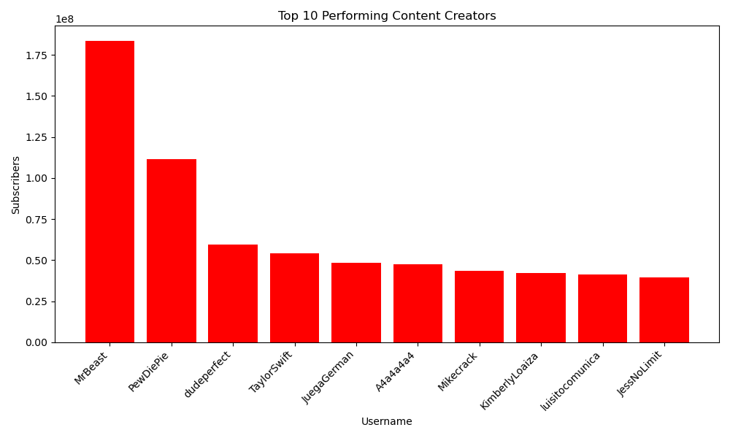
Top Performing Content Creators
The dashboard above shows the top 10 streamers like MrBeast, PewDiePie, Dude Perfect, Taylor Swift, JuegaGerman, A4a4a4a, Mikecrack, Kimberly Loaiza, Luisito Comunica, and JessNoLimit

Slide 16
Recommendations
Collaborative Filtering:
Implement collaborative filtering to recommend content based on the preferences and behaviors of similar users. Collaborative filtering can be user-based or item-based.
Use collaborative filtering to identify users with similar preferences and recommend content that those users have interacted with.
Content-Based Filtering:
Leverage content-based filtering to recommend content similar to what a user has previously interacted with.
Use the feature vectors created earlier to find streamers and content that are similar to the user's historical preferences.
Machine Learning Models:
Train machine learning models to predict user preferences based on historical interactions and content features. Use these models to generate personalized recommendations.
Evaluation and Feedback Loop:
Implement mechanisms to continuously evaluate the performance of the recommendation system. Collect user feedback on recommended content to refine and improve the models over time.
By combining collaborative filtering, content-based filtering, and machine learning models, the proposed system can offer users a more personalized and engaging experience on YouTube. Regularly update and refine the system based on user feedback and evolving content trends.

